Slide 1
Weekly Report
Wensheng Cheng
2022.3.7-3.13

Slide 2
Last discussion
No use heatmap in RPN process, since it’s not precise enough. Use it in the RPN stage would miss TPs. We can use template appearance feature after RPN stage.
How is the effect of scale limitation?
Conclusion: necessary, it can effectively remove objects much larger than our template.
How is the feature discriminative ability of RPN model(COCO)?
Conclusion: not very good, for complex scenes with many foreground objects, the similarity between some FPs and the template could be higher than that between TP and the template.
Thought: try to use ImageNet classification model to extract feature.

Slide 3
This week
Check the box score statistics in RPN method, try RPN feature from multiple FPN levels, try ImageNet pretrained backbone to extract box feature, and do numerical test on the RPN method.
How about the ImageNet backbone?
Conclusion: not good. For some objects, it’s better than RPN feature, but it’s worse for other objects.
How about the numerical test result of RPN method?
Conclusion: not as good as earlier iterative way.
Thought: for the 1st image, which way we should choose.

Slide 4
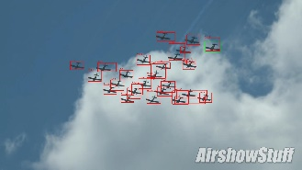
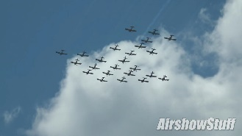
Full Process
Output
Find objects on
first img
Semi-supervised detection
Data association
Filter
Iterative search
or
Filter
RPN based method
Input

Slide 5
Numerical Result
Following train_1_test_40 way, we get the detection performance results of RPN method. Till current results, iterative method performs better than the RPN method.
 | AP | AP50 | AP75
gt | 38.28 | 77.50 | 32.57
baseline(iter_1) | 26.48 | 57.77 | 20.51
iter_2 | 27.55 | 62.07 | 20.40
rpn | 19.29 | 47.42 | 12.37

Slide 6
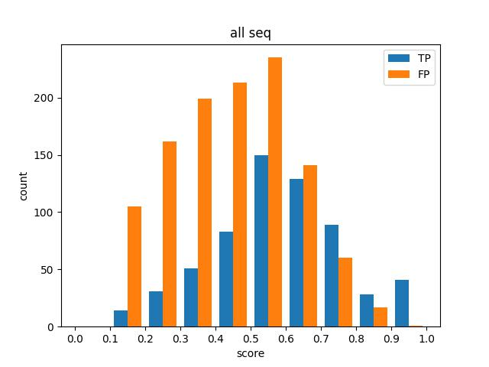
Box Score Stat
Box score stat for first images of all 40 sequences with gt_iou_th_05.

Slide 7
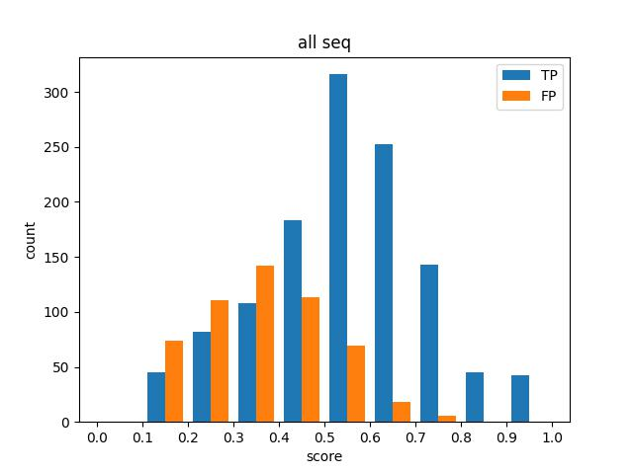
Box Score Stat
Box score stat for first images of all 40 sequences with gt_iou_th_00.

Slide 8
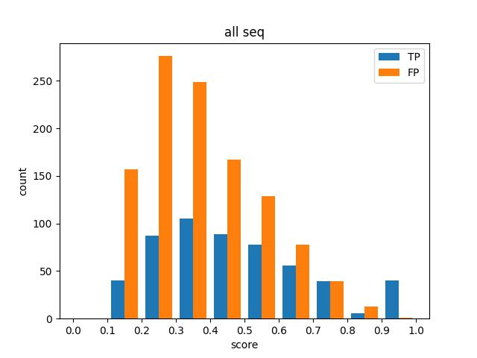
Box Score Stat-All FPN Levels
Box score stat for first images of all 40 sequences with gt_iou_th_05.

Slide 9
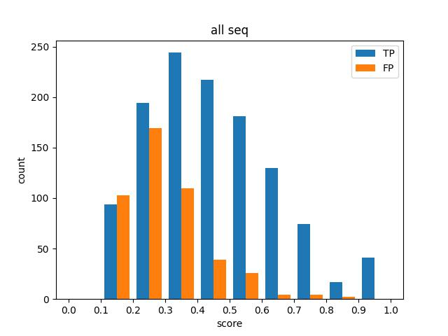
Box Score Stat-All FPN Levels
Box score stat for first images of all 40 sequences with gt_iou_th_00.

Slide 10
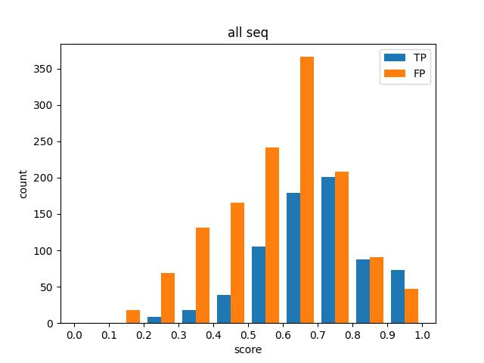
Box Score Stat-ImageNet Res50
Box score stat for first images of all 40 sequences with gt_iou_th_05.

Slide 11
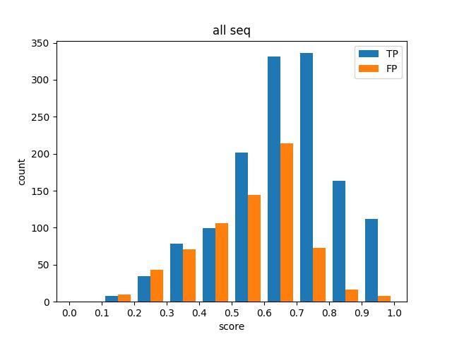
Box Score Stat-ImageNet Res50
Box score stat for first images of all 40 sequences with gt_iou_th_00.

Slide 12
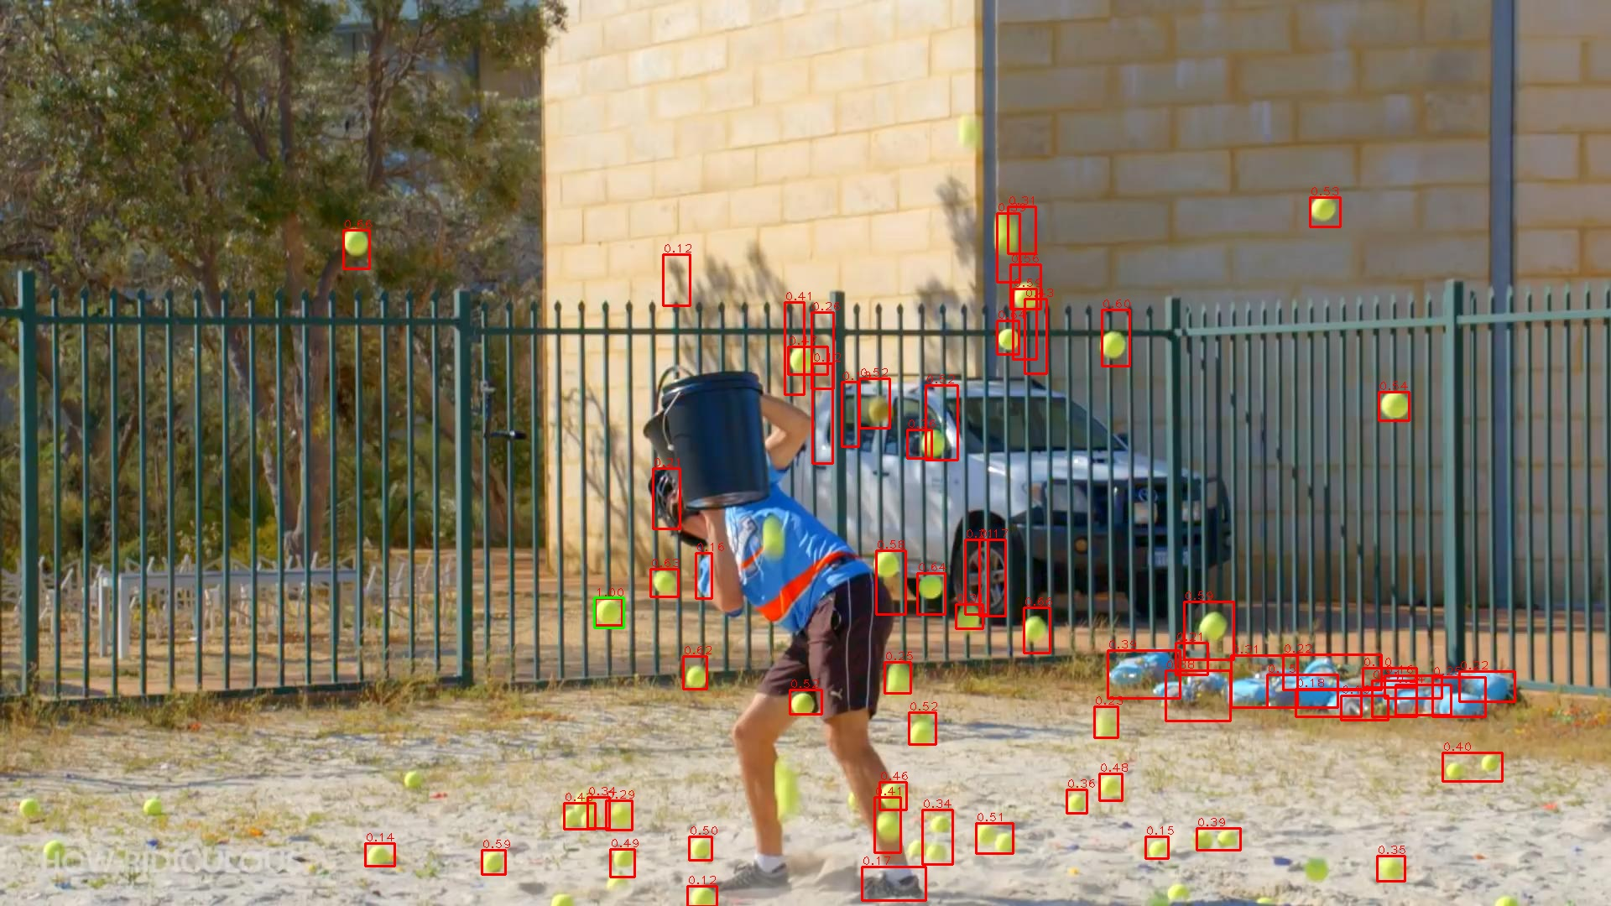
Featmap Similarity-RPN

Slide 13

Featmap Similarity-ImageNet

Slide 14
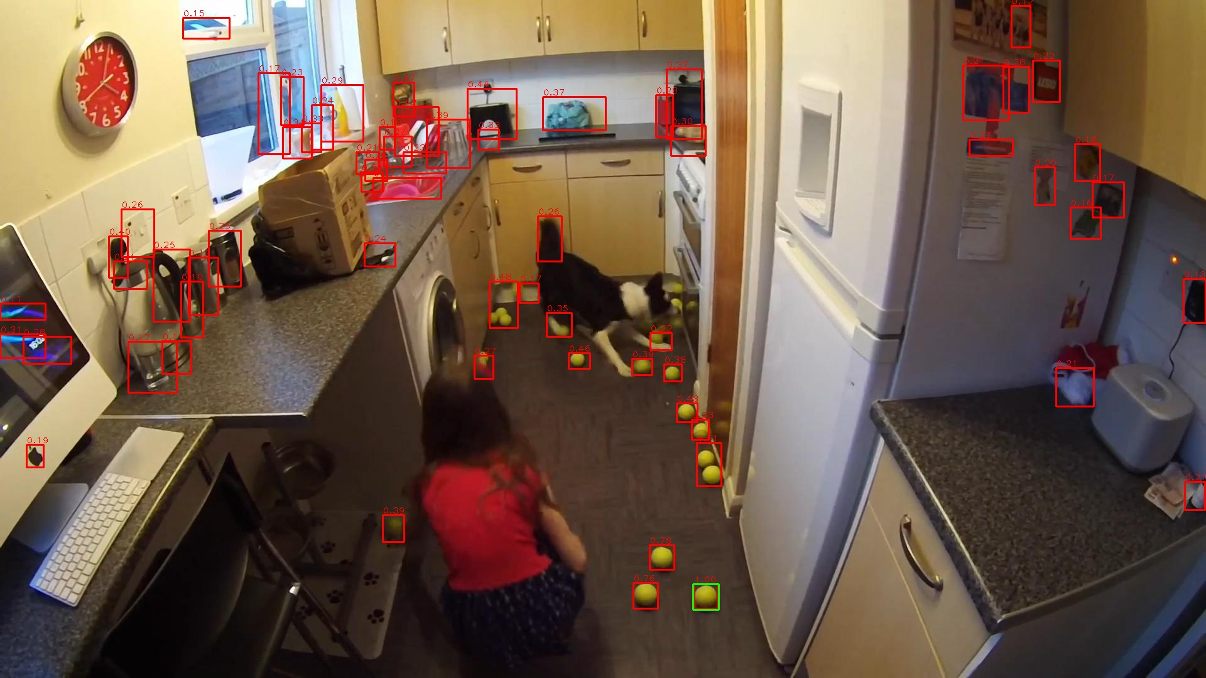
Featmap Similarity-RPN

Slide 15

Featmap Similarity-ImageNet

Slide 16
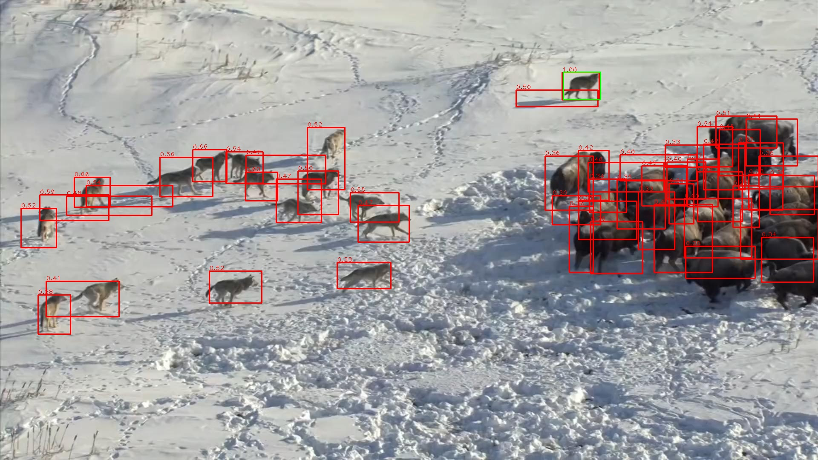
Featmap Similarity-RPN

Slide 17
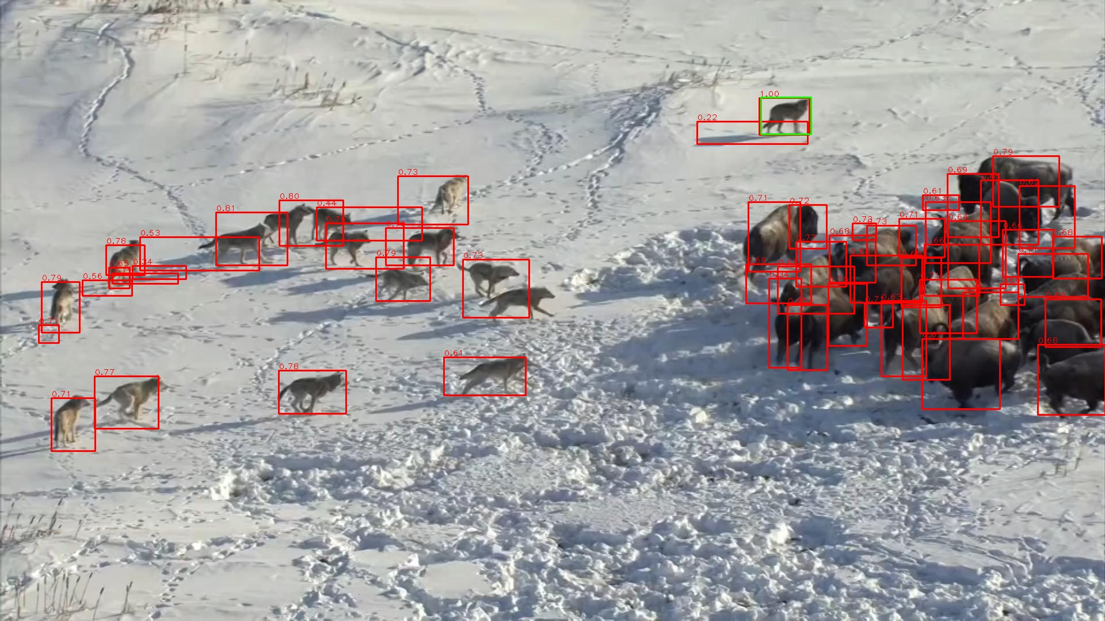
Featmap Similarity-ImageNet

Slide 18
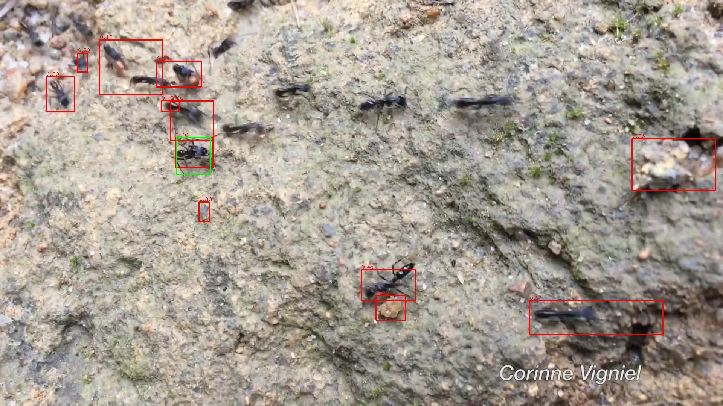
Featmap Similarity-RPN

Slide 19

Featmap Similarity-ImageNet

Slide 20
End
End and Thanks!

